Slide 1
Engineering Team
Desert Camp Planning Task

Slide 2
Team Task
Design a suitable village, based next to the track, for the team to live in whilst out at Hakskeen Pan in South Africa.
Notes:
2

Slide 3
Team Task
Remember!
We need to look after the team…
AND the car!
Notes:
3

Slide 4
Weather
Day – Hot and dry
Night – Very cold!
Quite strong winds
Floods in rainy season
Notes:
4

Slide 5
Location
Dry lake bed – dust!
Nearest town – 154 miles away
Notes:
5

Slide 6
Don’t forget…
Shelter – Team & Car
Equipment
Power Sources
Medical Arrangements
Evacuation Procedures
Food & Water
Notes:
6

Slide 7
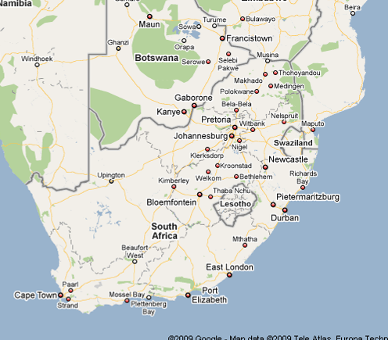
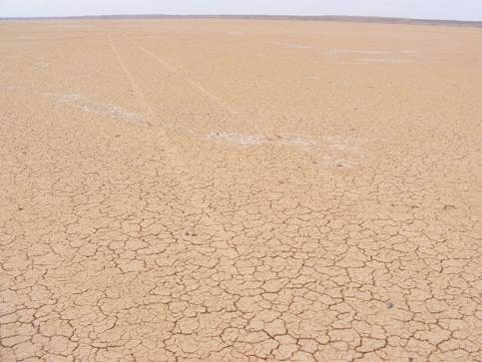
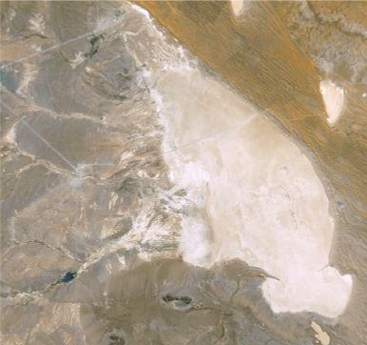
Where are we doing it?
Hakskeen Pan
Notes:
7

Slide 8
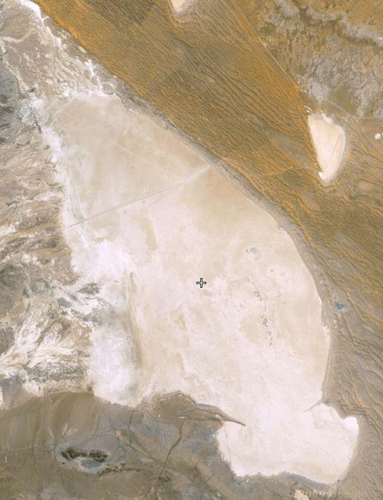
The Desert Layout
Base Camp
Tarmac Road
Public Access Road
Public Viewing Area
Timing Stand
Team Access Road
Fence
Notes:
Our site in the desert
Next slide – Clearing the stones
8

Slide 9
Tasks
Research Hakskeen Pan – What Challenges will you have to overcome to run a Land Speed Record Car?
Plan out your Desert Camp on A3 paper.
You have five minutes to present your plans to the team, Why is your design the best solution?

